Slide 1
Deeper Into Tableau
Lesson 18.2
Notes:
1.1

Slide 2
Class Objectives
By the end of this lesson, you will be able to:
Create groups and sets
Create maps and use built-in U.S. Census data
Create custom calculations
Apply LOD calculations

Slide 3
Activity: Warm-Up
In this warm-up activity, you will create visualizations using data on colleges and universities
15 Minutes
Notes:
2.2

Slide 4

Activity: Explore Data
Instructions:
Use the provided dataset to visualize interesting questions, such as the following:
Is there a relationship between an institution's average ACT or SAT scores and the average number of doctorates awarded?
Which regions in the United States have the greatest percentage of students receiving federal grant aid?
Is there a correlation between SAT scores and regions?
Do foreign undergraduates prefer institutions whose highest offered degree is a doctorate, master’s, or bachelor's?
Of institutions that offer bachelor's, master's, or doctorates as the highest degrees, which have the highest graduation rates within four years?
Is there a relationship between tuition and SAT scores?
Hint:
Don’t forget to save to Tableau Public once finished.
Notes:
2.2

Slide 5
Notes:
2.3

Slide 6
Groups and Sets
Notes:
1.1

Slide 7
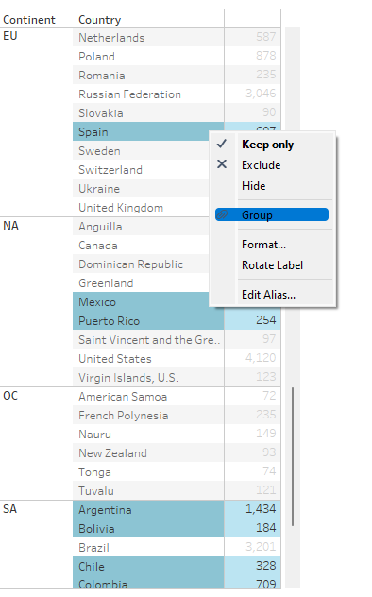
Instructor Do: Groups and Sets
We can group multiple members in a field into a group. For example, if companies A and B have recently merged, we can group them under a single entity to aggregate their figures.
In ins_groups_sets, go to the Group tab. Each continent's countries, as well as the total paid fees, are shown. If we want to study a group by its language, it would make sense to group all the Spanish-speaking countries.
Select multiple countries, right-click, and choose Group
Notes:
2.1

Slide 8
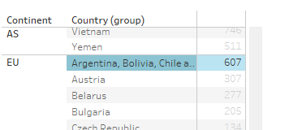
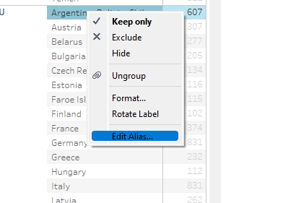
Instructor Do: Groups and Sets
Now, they are grouped, and their paid fees are also aggregated
To change the name of the group, right-click it and choose “Edit Alias”
Similarly, members of a field can be grouped into sets in Tableau. Sets are more flexible than groups; a set's members can be drawn from multiple dimensions or even conditions.
Notes:
2.1

Slide 9
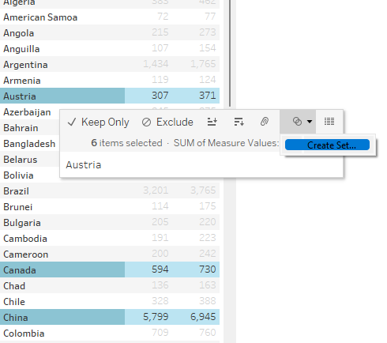
Instructor Do: Groups and Sets
We can create a set of members from the same field using the following steps:
Go to the “Sets0” sheet. Suppose that we are offering a special discount to Austria, Canada, and China. Click the country members that will have a discount.
With the selected countries highlighted, hover over one until a menu appears. Select “Create Set”... from the menu.
Notes:
2.1

Slide 10
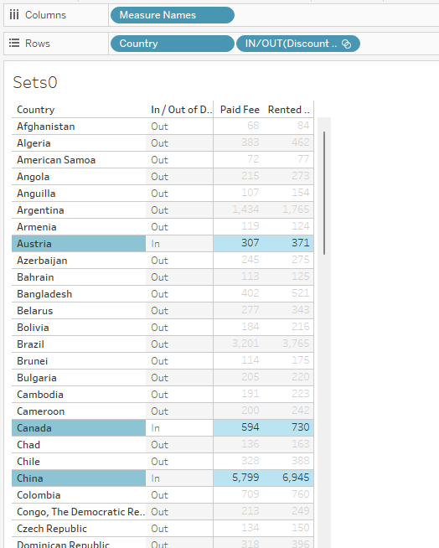
Instructor Do: Groups and Sets
Name the set “Discounted Countries” or something similar. It will appear in the Tables listing on the far left of the window. Drag it to the Rows shelf
A set bifurcates a field into the following two groups:
The In group, whose members meet the set's criteria
The Out group, whose members do not meet the set's criteria
With these groups, we can perform additional operations and visualizations
Notes:
2.1

Slide 11
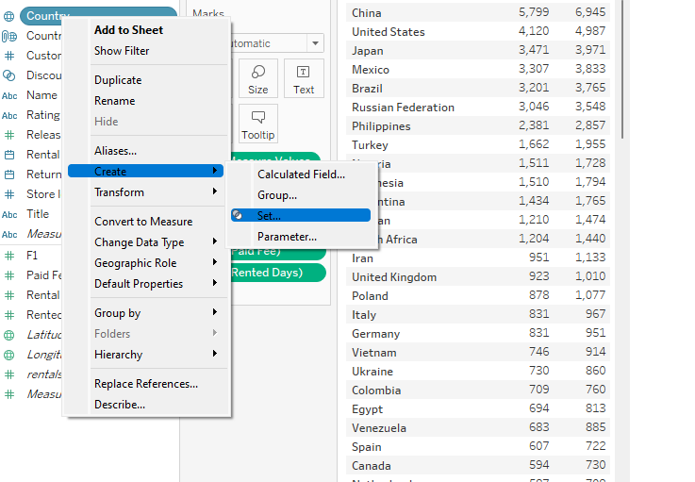
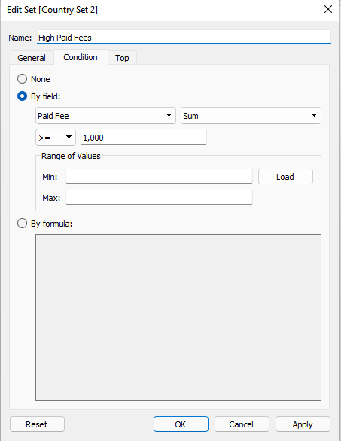
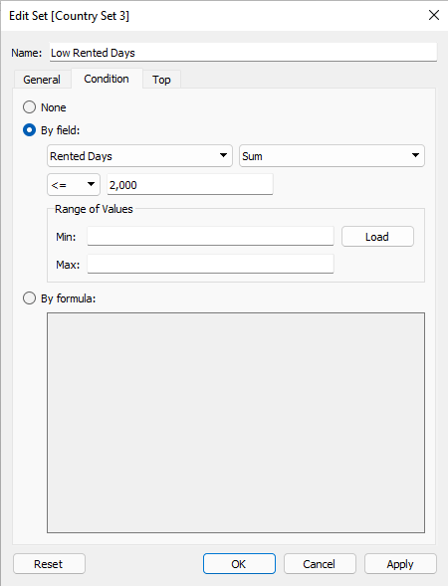
Instructor Do: Groups and Sets
We can also create a set to select members that meet a defined criterion. In the following example, we'll create sets to select movie titles that meet two criteria: high paid fees and low rented days.
Notes:
2.1

Slide 12
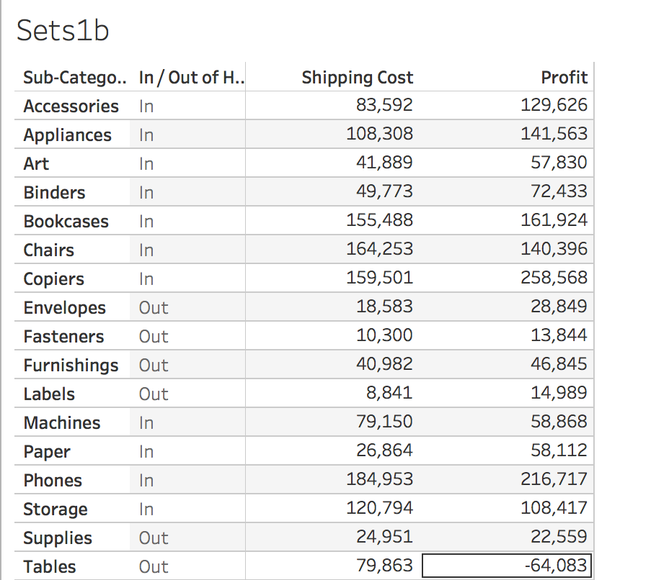
Instructor Do: Groups and Sets
Right-click on Country, and select Create then Set. Select Condition, and define the criteria. In this example, we're filtering for total profits higher than $1,000. Repeat the process for low rented days. Dragging either of these to the Rows shelf will display the in and out sets.
Notes:
2.1

Slide 13
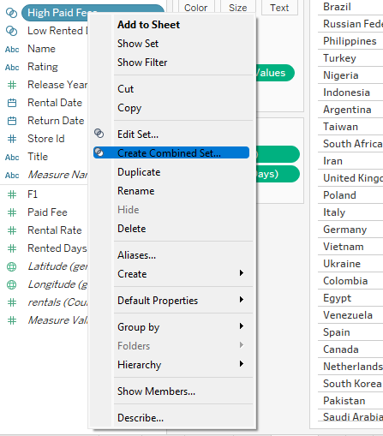
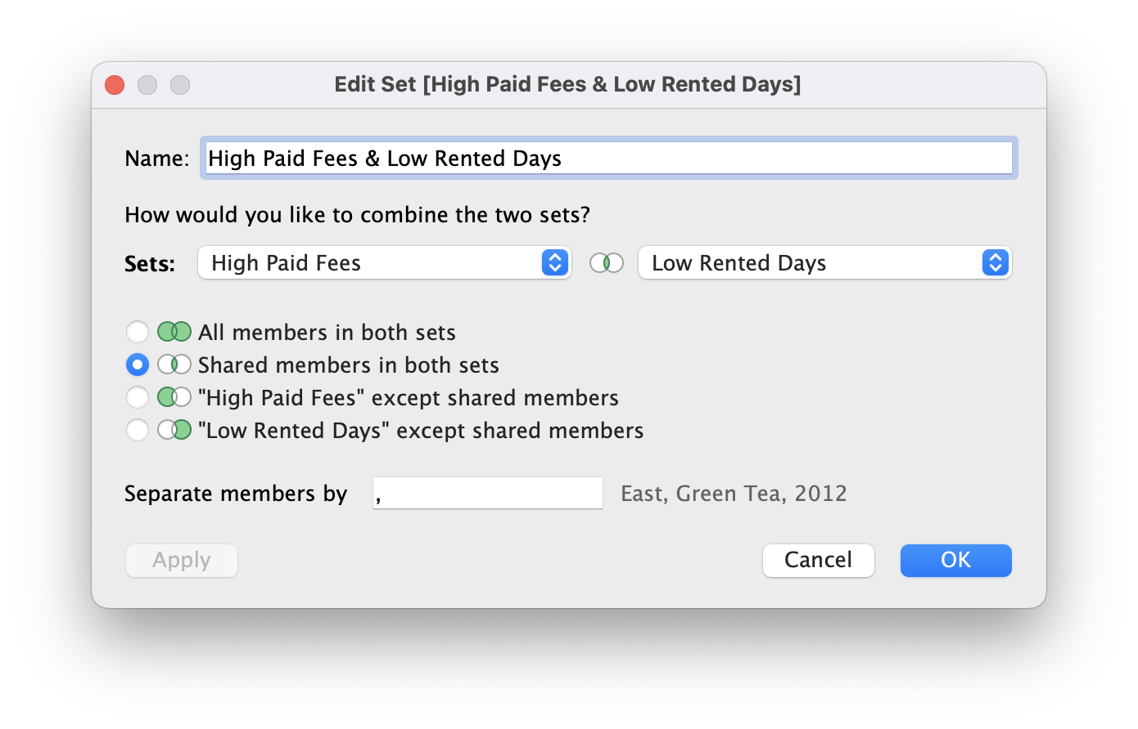
Instructor Do: Groups and Sets
We can combine the criteria created by the two sets. Right-click on either pill of a set; in this case, right-click on the High Paid Fees set, and select Create Combined Set. Define the two sets, and select inner join.
Notes:
2.1

Slide 14
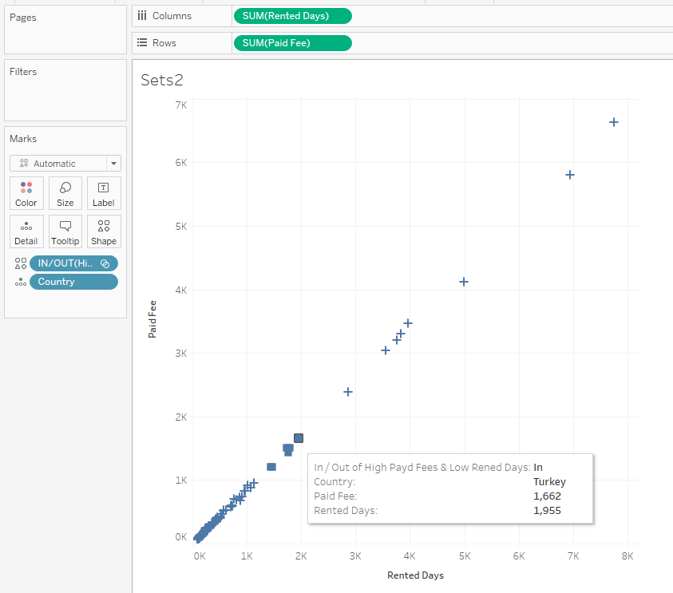
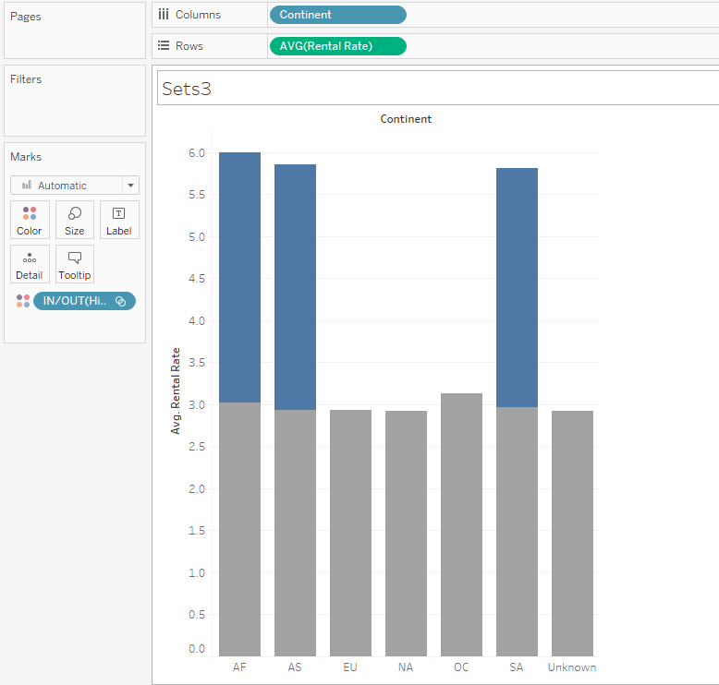
Instructor Do: Groups and Sets
In sheet Sets2, we can now use the combined set filter to visually identify Countries that meet the criteria. Sheet Sets3, captured in the following image, visualizes whether countries that have low rented days and high paid fees have higher rental rates than countries that don't meet the criteria.
Notes:
2.1

Slide 16
Activity: Movie Rental Groups and Sets
In this activity, you will use groups and sets to explore movie rentals at a fictitious rental shop.
15 Minutes
Notes:
2.2

Slide 17
Activity: Movie Rental Groups and Sets
Instructions:
Import the xlsx file from the Resources folder.
Drag the “rentals” sheet into the area labeled “Drag tables here.”
Group the “Rented Days” field into Short, Medium, and Long rentals.
In the “Short” group, put any rental shorter than 3 days.
In the “Medium” group, put any rental from 3 days to 7 days.
In the “Long” group, put any rental longer than 7 days.
Create a chart comparing the Rented Days groups by average Paid Fee.
Create a set for kids movies.
The kids movies set should have all movies rated G and PG as “In” and the other ratings as “Out.”
Rename the aliases for the set to “Kids Movies” and “Other.”
Create a chart comparing the total number of rentals between kids movies and other movies.
Create a chart comparing the average fees paid between kids movies and other movies.
Create a chart comparing the average rental duration between kids movies and other movies.
Notes:
2.2

Slide 18
Notes:
2.3

Slide 19
Calculations
Notes:
1.1

Slide 20
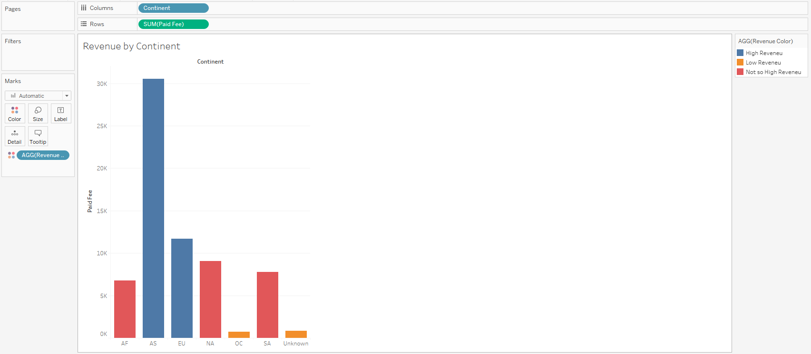
Instructor Do: Calculations
In addition to Tableau’s built-in operations, we can also create custom conditional statements and calculations. For example, Tableau can handle IF statements. Using an IF statement, continents with high revenue are colored blue, less revenue are colored red, and less than 5K in revenue are colored orange.
Notes:
2.1

Slide 21
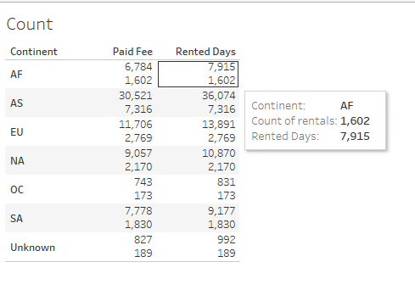
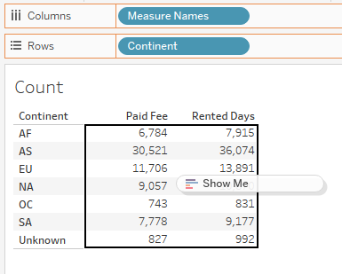
Instructor Do: Calculations
Tableau can also deal with unknown quantities, as we’ll find in the IIF1 sheet. Create a new calculated field, and enter the code. Instead of IF, the statement in the preceding code is IIF.
This means if the rented-days total is greater than 1,000, a subcategory is labeled "High Rentals."
Otherwise, it is labeled "Low Rentals." However, if the quantity cannot be evaluated, it is "Unknown."
Notes:
2.1

Slide 22
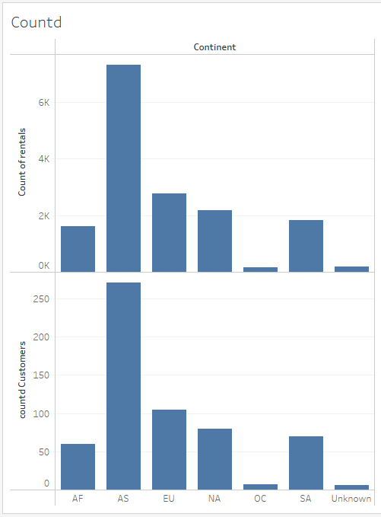
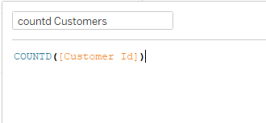
Instructor Do: Calculations
Tableau can also calculate the distinct number of dimensions by using the COUNTD function, which is short for "count distinct." Open the Countd worksheet. Counting the number of rentals across continents is simple, but what if we want to see the number of unique customers in each continent?
Notes:
These charts indicate that a relatively small customer base is responsible for a large number of rentals. That is, individual clients may be responsible for multiple rentals.

Slide 23
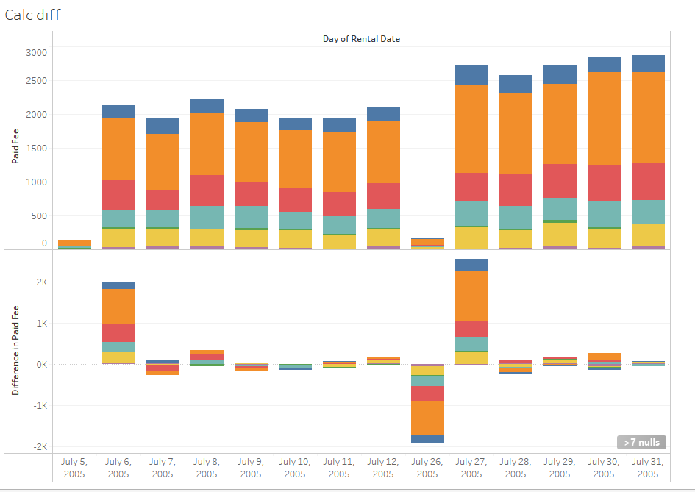
Instructor Do: Calculations
By default, each day's sales are compared against the previous day’s sales, but this can be changed by clicking on the Sales pill again, selecting Relative to, and then the desired option.
The top chart is a stacked bar chart of daily revenue in all the continents.
The bottom chart shows the difference between one day's revenue and the previous day's revenue.
The bottom chart can be created by dragging the Sales pill to Rows, clicking on the pill to select Quick Table Calculation, and then selecting Difference.
Notes:
2.1

Slide 25
Activity: Calculations
In this activity, you will create visualizations using a dataset on motor vehicle accidents in the United Kingdom in 2020.
10 Minutes
Notes:
2.2

Slide 26
Activity: Calculations
Instructions:
Try to create visualizations for the following questions:
What are the most dangerous hours that produce casualties?
What are the most dangerous months that produce casualties?
What speed limit is the most common for accidents to occur in?
Does the speed limit impact the average number of casualties?
What are the most common weather conditions for accidents?
Do light conditions have any impact on accidents?
Are there any possible problems or issues with these visualizations?
Use calculations and logical statements to enhance your visualizations, such as:
Using conditional logic to color dangerous months, locations, and hours.
Charting the increase or decrease in the number of casualties in each month relative to the previous month.
Feel free to revisit earlier datasets to create calculations.
Notes:
2.2

Slide 27
Notes:
2.3

Slide 28

Notes:
-------------------
Image source: AdobeStock_56885471

Slide 29
Maps
Notes:
1.1

Slide 30
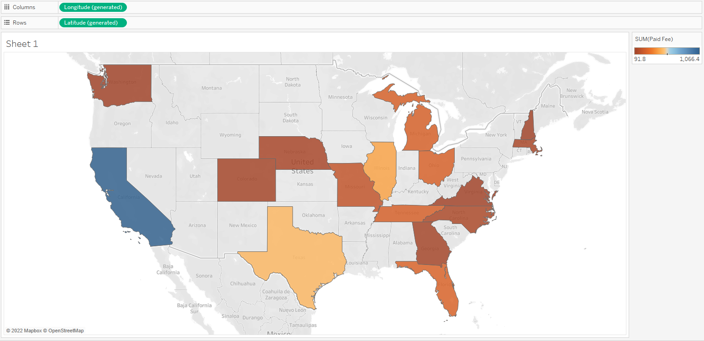
Instructor Do: Maps
Creating a map in Tableau is simple. Below is a map of total profits by state.
Notes:
2.1

Slide 31
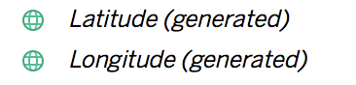
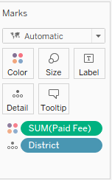
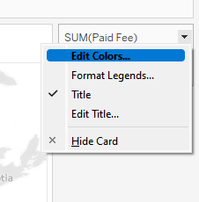
Instructor Do: Maps
Tableau automatically generates the latitude and longitude coordinates of locations in our data.
The Latitude (generated) pill goes to the Rows shelf because latitude lines run horizontally.
The Longitude (generated) pill goes to the Columns shelf because longitude lines run vertically.
To generate this map, simply drag the Paid Fee pill to Color in the Marks pane.
The colors can be tweaked by clicking the drop-down menu in the legend and choosing Edit Colors
Notes:
2.1

Slide 32
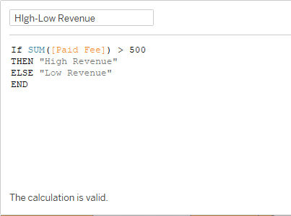
Instructor Do: Maps
To simply categorize high-revenue states against low-revenue states, we can create a custom logical function, (Analysis -> Create Calculated Field), as used in the following code:
Notes:
2.1

Slide 33
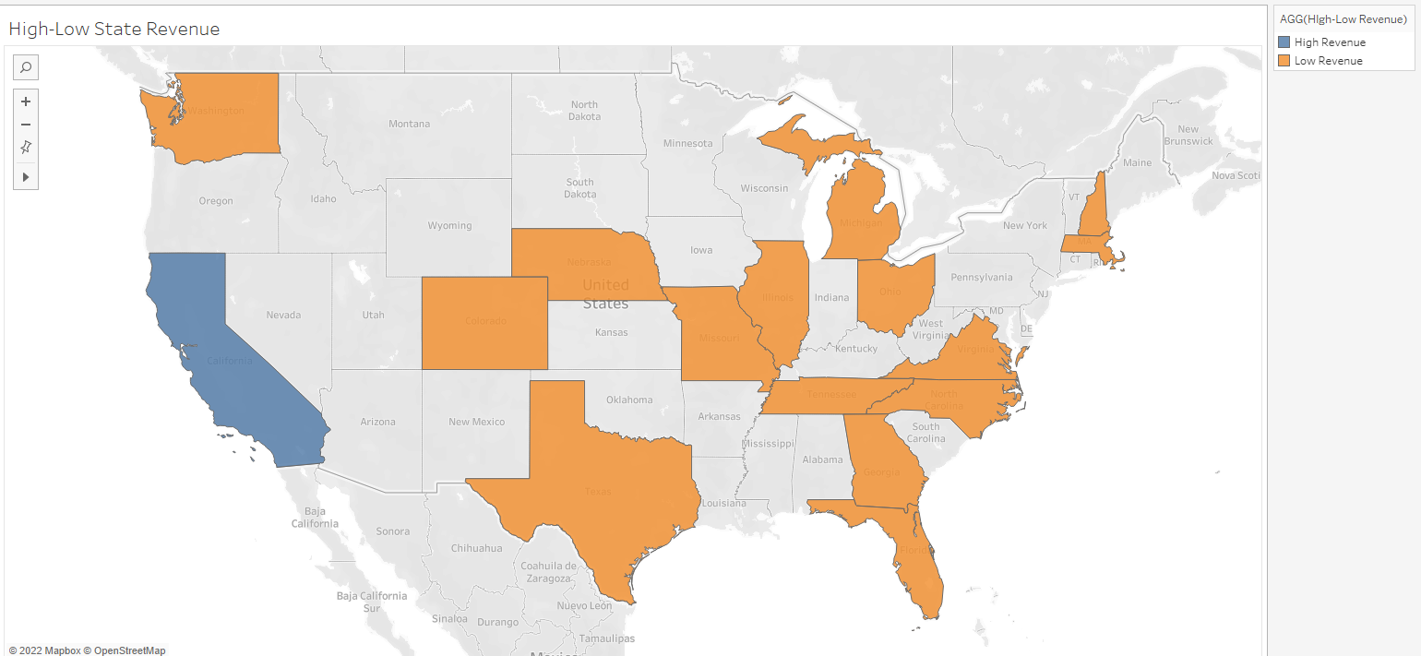
Instructor Do: Maps
The pill for the custom field is then dragged to the Color marks to view this map below:
Notes:
2.1

Slide 34
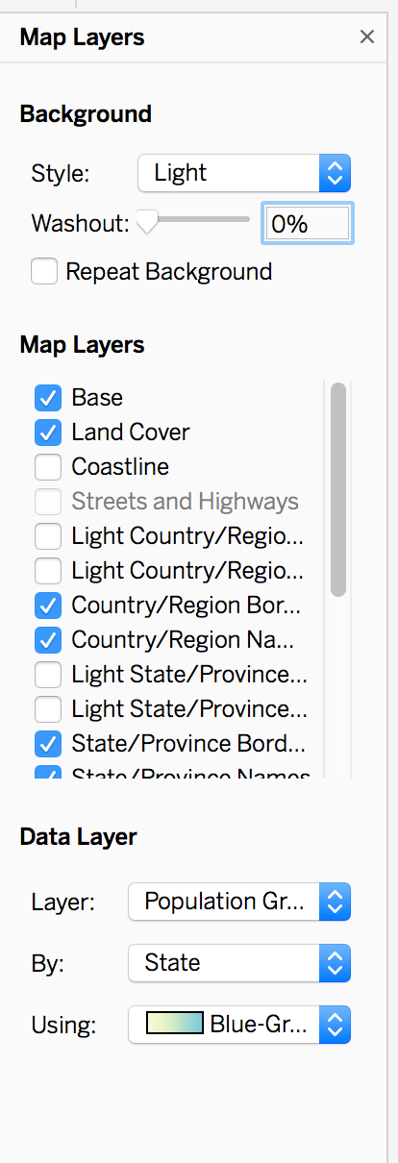
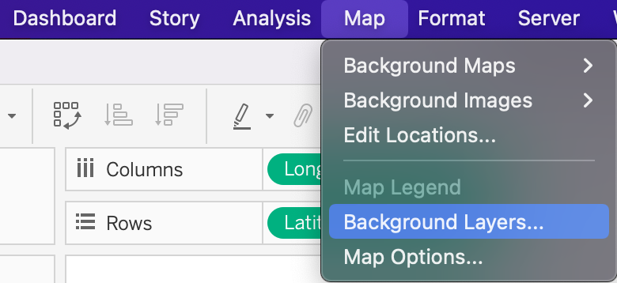
Instructor Do: Maps
Tableau has built-in layers to add data from the U.S. Census!
Click Map in the menu and then Map Layers.
We have many different layers to choose from, including census information and county/state boundaries.
Notes:
2.1

Slide 36
Activity: Maps 1- Earthquakes
In this activity, you will chart the intensity of earthquakes over time. You will also create a map that compares the magnitude of earthquakes versus median household income.
10 Minutes
Notes:
2.2

Slide 37
Activity: Maps 1 - Earthquakes
Instructions:
Part 1:
Use earthquakes_database.csv to plot the magnitude of earthquakes measured from 1965 to 2016.
Earthquakes should be stratified by magnitude, using the Size and Color marks.
Use Tableau's built-in Census data to determine whether any relationship exists between earthquakes and 2017 median household income, by county
Part 2:
In a separate worksheet, determine if there has been any trend in the magnitude of earthquakes measured globally over the years.
Create a global map of earthquakes, with each earthquake's magnitude reflected on the map by size and color. Remember that the Richter scale is logarithmic. How might you reflect this relationship on the map?
Notes:
2.2

Slide 38
Notes:
2.3

Slide 39
Activity: Maps 2 - Unemployment
In this activity, you’ll develop more familiarity with map building in Tableau.
10 Minutes
Notes:
2.2

Slide 40
Activity: Maps 2 - Unemployment
Instructions:
Use employment.csv, a dataset constructed from the Bureau of Labor Statistics data, to visualize unemployment in the United States.
Create a map of unemployment, by county, between 2008 and 2016. Which areas in the United States have been hit hardest during that period?
Create an unemployment map, by county, for 1990 through 1998. How does it compare and contrast with the 2008-2016 map?
Create a map of counties with the highest rates of unemployment over the whole dataset. Use Tableau's built-in Census data to discover the relationship, if any, between counties with the highest rates of unemployment and the median per capita income by county.
Notes:
2.2

Slide 41
Notes:
2.3

Slide 42
Dashboard
Notes:
1.1

Slide 43
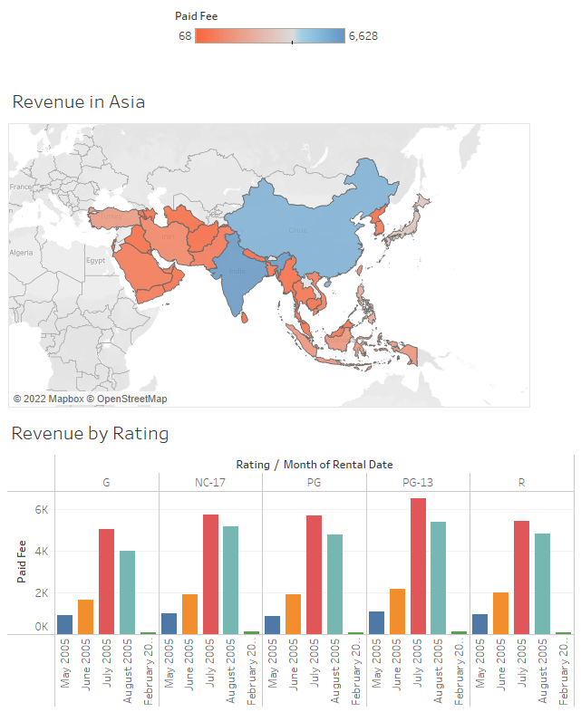
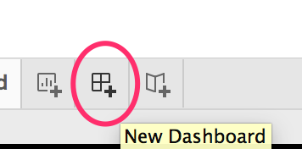
Instructor Do: Dashboard
Dashboards allow for a bird's-eye view of several visualizations at once; in Tableau, we can also have elements that interact with each other. We can also have multiple visualizations on a single page.
Notes:
2.1

Slide 44
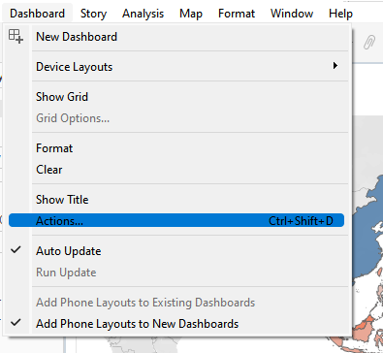
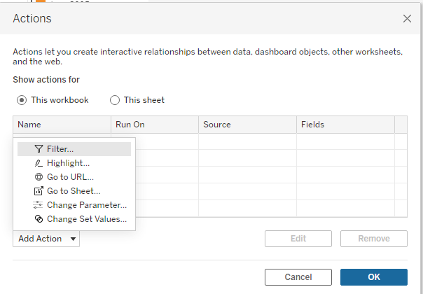
Instructor Do: Dashboard
To create interactive actions, where an action on one chart can affect the visualization in another:
Go to Dashboard, then select Actions…
Click Add Action and, in this case, Filter
Notes:
2.1

Slide 45
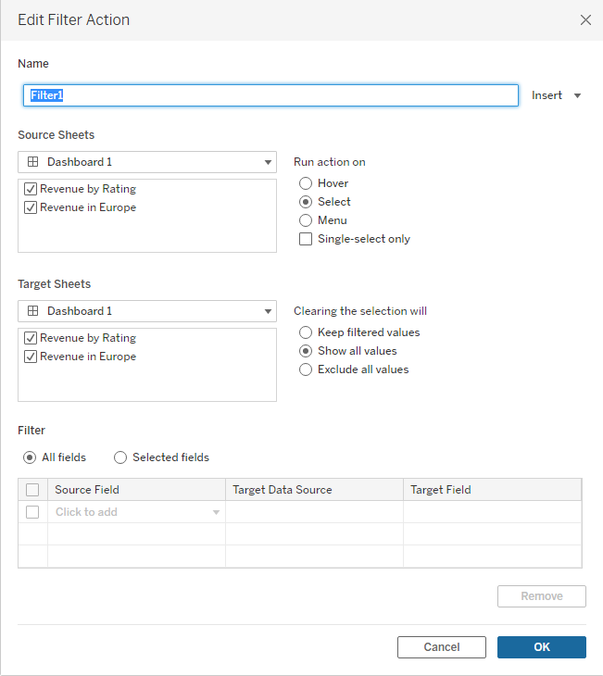
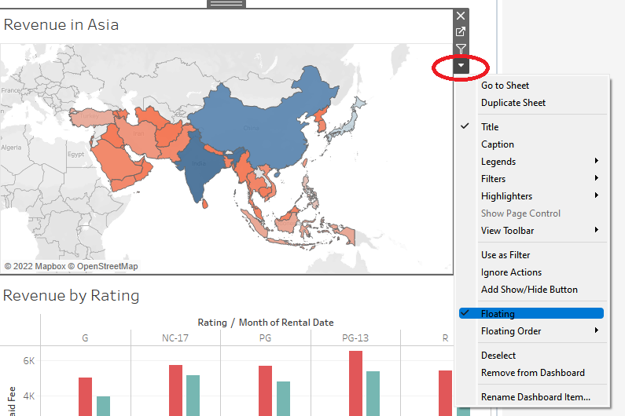
Instructor Do: Dashboard
Click Select under “Run action on:”, and then specify the source and target sheets for the action. To move each chart, click the drop-down arrow, then select Floating.
Notes:
2.1

Slide 46
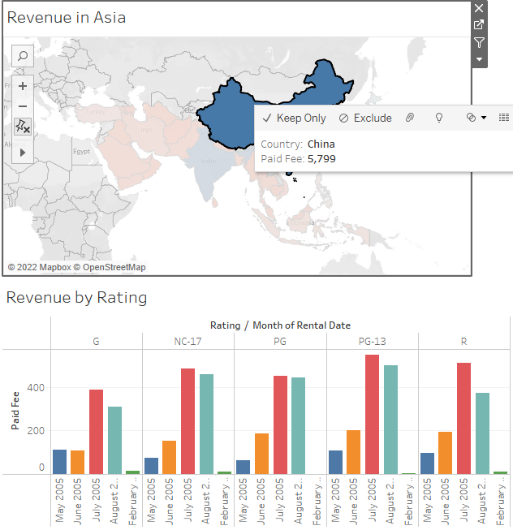
Instructor Do: Dashboard
With that, the charts are now interactive!
Clicking China on the map changes the Paid Fee by Rating bar chart to reflect only the values for China across the months and by rating.
Notes:
2.1

Slide 47
Activity: Dashboard - Most Fun Neighborhood in NYC?
In this activity, you’ll find the “most fun” neighborhoods in New York City by mapping bars that have received the highest number of noise complaints.
10 Minutes
Notes:
2.2

Slide 48
Activity: Dashboard - Most Fun Neighborhood in NYC?
Instructions:
Part 1: Use the provided dataset to create a map of NYC bars, broken down by boroughs.
It should show the locations of bars that have been subject to noise complaints.
A bar should be proportionately represented by the number of complaints it has received.
A bar should also reflect the borough in which it is located.
Each zip code in the city should be displayed on the map, as in the following image. Location is everything!
Part 2:
Create a bar chart that breaks down, per borough, the type of building versus the number of complaints received
Create a dashboard of the worksheets you just created.
Notes:
2.2

Slide 49
Notes:
2.3

Slide 50
Level-of-Detail (LOD)
Notes:
1.1

Slide 51
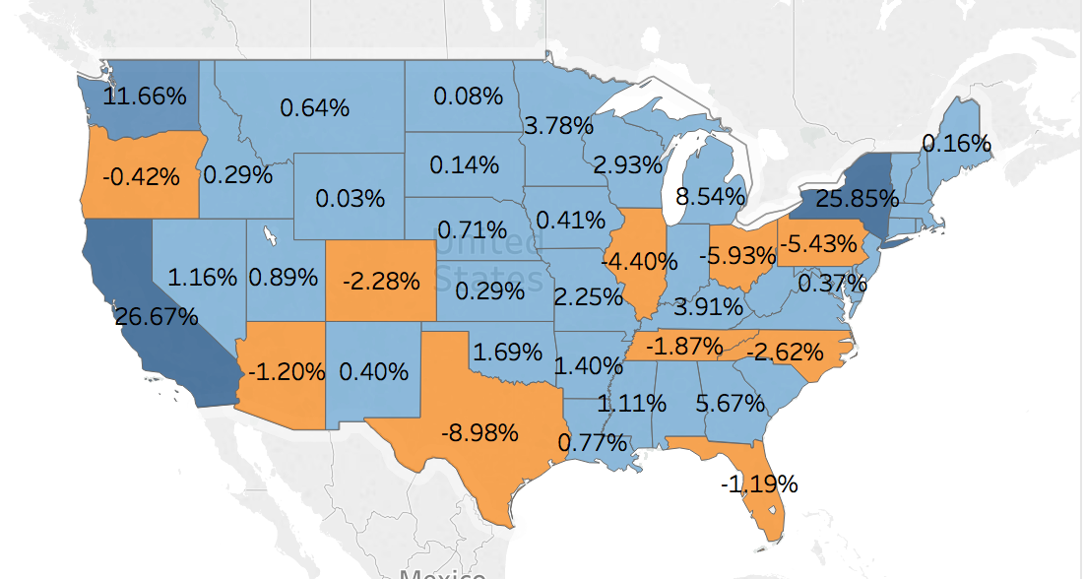
Instructor Do: Level-of-Detail
LOD works so that we can incorporate data that is not available in the current level of visualization.
Notes:
2.1

Slide 52
Instructor Do: Level-Of-Detail
Here we have a map, which shows state-by-state contributions (by percentage) to total national profit:
The map’s level of visualization is by state.
If the level of visualization were national, only a single profit number would be shown for the whole U.S.
In addition to the state-level profit, the total national profit, which is a figure from a different LOD than the current visualization, is required.
The number shown on each state is state profit/total national profit.
Notes:
2.1

Slide 53
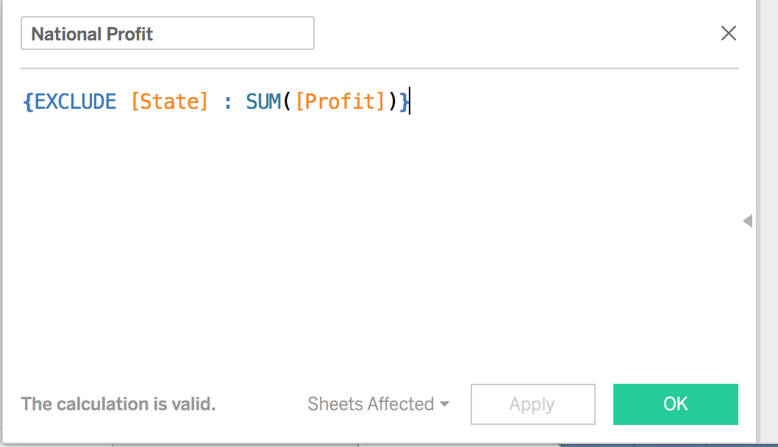
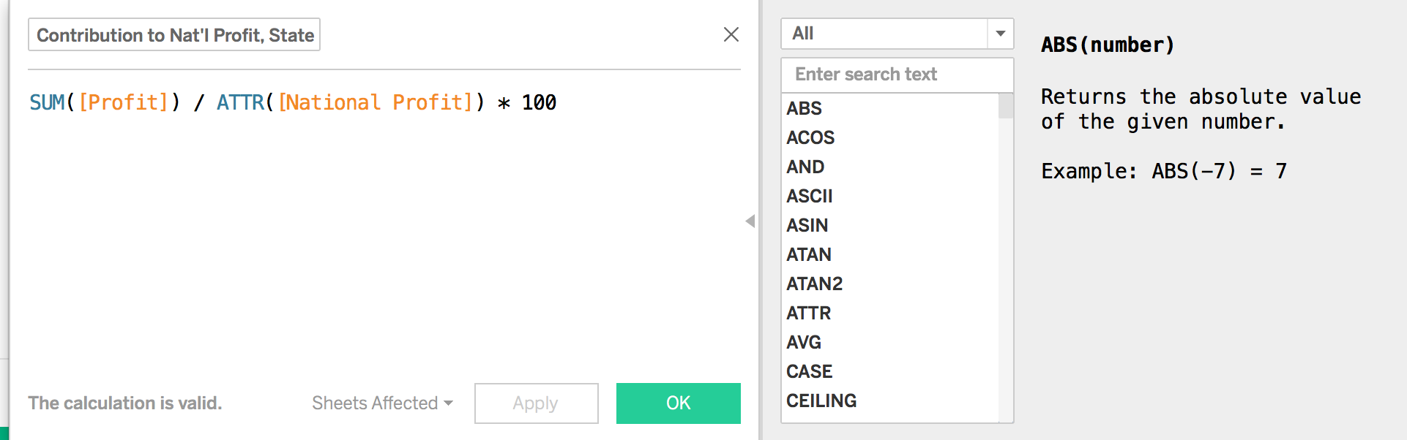
Instructor Do: Level-Of-Detail
An important concept in LOD calculations is aggregation versus granulation.
Aggregation means a higher, more abstract level; in this case, the national level is more aggregated than the state level.
Granulation means a lower, more specific level; in this case, the state level is more granular than the national level.
For example, at the state level of visualization, if we exclude the state level from a profit calculation, we are referring to the national level of calculation, which is more aggregated.
Notes:
2.1

Slide 54
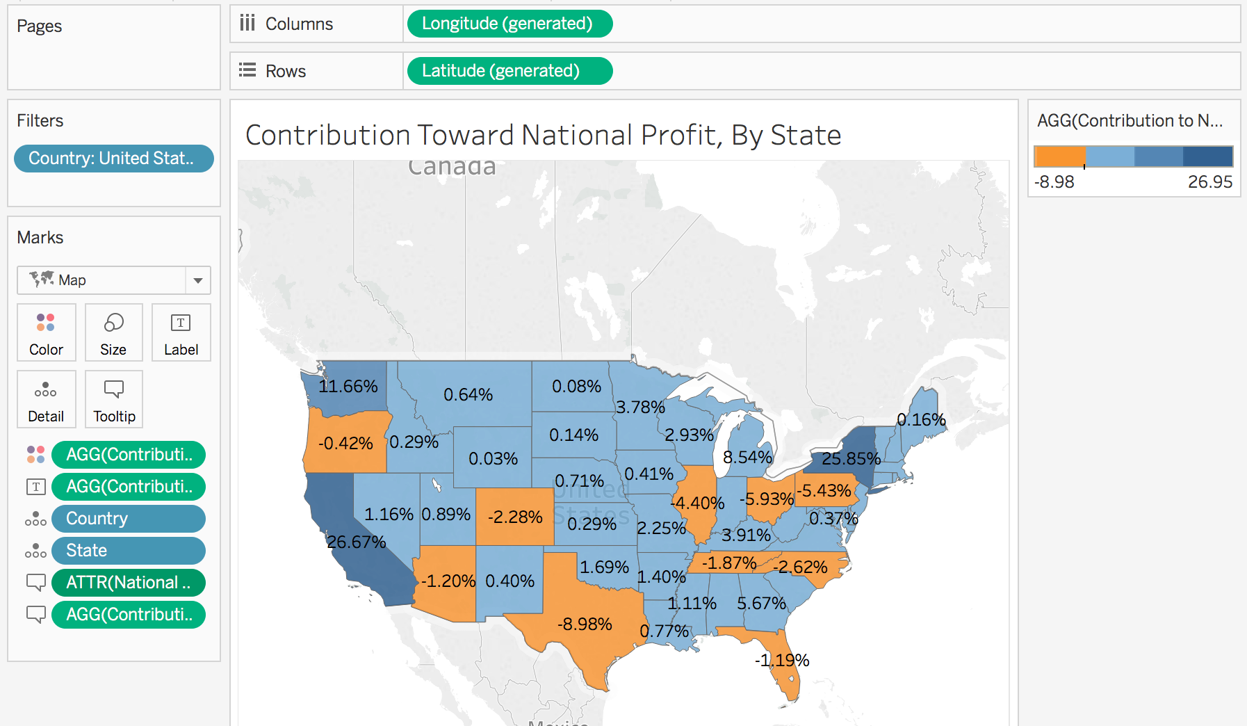
Instructor Do: Level-Of-Detail
Let’s refresh on the concept of attribute, which is also important in LOD calculations:
ATTR works at the row level: If all rows have the same value, ATTR returns a value; if all rows do not have the same value, it returns an asterisk.
At the state level, since the national profit is identical for all states, it can be characterized as an attribute.
At the state level, since all rows (states) do not have the same value, each state’s profit cannot be characterized as an attribute.
This again highlights the concept of aggregation versus granulation.
Notes:
2.1

Slide 55
Activity: Level of Detail
In this activity, you will practice creating LOD calculations.
15 Minutes
Notes:
2.2

Slide 56
Activity: Level of Detail
Instructions:
With the Global Superstore Excel workbook, create a visualization of state-level profit, which visualizes the contribution of each state to the national profit.
In the next map, visualize each city's contribution toward the state's total profit.
The label for each state is not the total sum of profits in that state. Rather, it is a state-level visualization of the average of the orders.
Hint:
For this map, you will need to research Tableau LOD syntax. What will you use instead of EXCLUDE?
Don’t forget to save to Tableau Public once finished.
Notes:
2.2

Slide 57
Notes:
2.3

